Slide 1
Securing Enterprise with Open Source and Freeware Tools
ICWA 2013
Presenter: Ketan Vyas
The views and opinions expressed during this workshop are those of the speaker alone and do not necessarily reflect the positions or opinions of employer or employer affiliates.

Slide 2
Disclaimer
The views and opinions expressed during this workshop are those of the trainer alone and do not necessarily reflect the positions or opinions of employer or employer affiliates. This workshop is based on trainer’s current knowledge on subject and personal experience. Please verify it independently before making decision based on it. In addition, any views or opinions expressed by audience during session are theirs and do not necessarily reflect trainer’s.

Slide 3

Learn your own way
Learn everything that is good from others, but bring it in, and in your own way absorb it; do not become others. Do not be dragged away out of this Indian life; do not for a moment think that it would be better for India if all the Indians dressed, ate, and behaved like another race
- Swami Vivekananda
Image Source: http://en.wikipedia.org/wiki/Teachings_and_philosophy_of_Swami_Vivekananda

Slide 4
Agenda
Security Basics
Identifying Security Risk for Web & Mobile Apps
OWASP Top10 Risks
Security Defect Patterns and Root causes
Tools & Techniques to Detect Vulnerabilities in Web/Mobile Applications
Security Testing Data Management
Reducing Security Risk with Secure Coding
Secure Coding Practices for .Net
Secure Coding Practices for Java

Slide 5
Security Basics

Slide 6
Fundamentals
Security Basics
Confidentiality
Integrity
Availability
Authentication (Who you are)
Authorization (What you can do)
Privacy
Nonrepudiation (Accountability)

Slide 7
Identity and Access Management
Security Basics
Identity Lifecycle Management
Registration
Access Management
Authentication
Authorization
Directory
Identity repository
Directory services
Identity management
Provisioning
Policy management
Federation
Self service
Cross Functions
Workflow
Delegation
Auditing
Source: http://cs.uwsa.edu/IAM/about.aspx

Slide 8
Data Lifecycle
Security Basics
Create
Store
Use
Share
Archive
Destroy
Format
Storage
Channels (i.e. web, mobile)
Access (i.e. user, role, location, time)
Permissions (i.e. Read, Write)

Slide 9
Threats to Enterprise
Security Basics
Top Threats
Network
Host
Application
Data
Abusing insecure functionality (i.e. unauthorised access to business critical data)
Privilege misuse (i.e. Remotely formatting mobile devices)
False trail (i.e. Performing transaction on someone’s name)
Layers to protect application and data
Employees
Theft & misuse (i.e. Credit card information)
Unauthorised access (i.e. Medical records)
Disclosure (i.e. Unaudited financial performance)

Slide 10
Protectors of Enterprise
Security Basics
Builders
Breakers

Slide 11
OWASP Top 10 Risks
Source: https://www.owasp.org/index.php/Category:OWASP_Top_Ten_Project

Slide 12
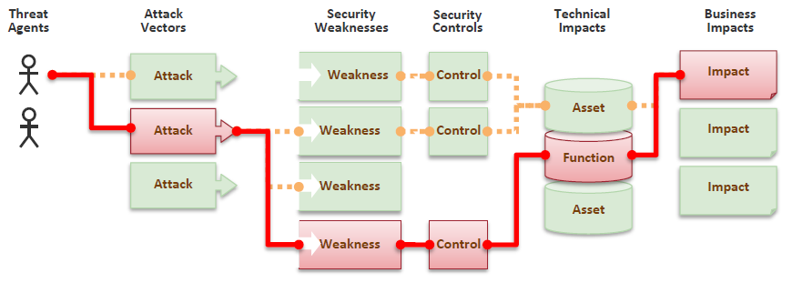
Business is all about managing Risk
OWASP Top10 Risks
Tell me and I forget.
Teach me and I remember.
Involve me and I learn.
- Chinese Proverb
Image Source: OWASP Top10 2013 document

Slide 13
A1 – Injection
OWASP Top10 Risks
Manipulate data sent to interpreters such as SQL, OS Shell, LDAP, XPath, Hibernate etc.
Interpreters take strings and interpret them as commands
SQL

Slide 14

A2 – Broken Authentication and Session Management
OWASP Top10 Risks
Authentication secret or session is compromised
Along with user sessions, it is also applicable to services, state and keys
Authentica tion

Slide 15

A3 – Cross-site Scripting (XSS)
OWASP Top10 Risks
User supplied data displayed in browser without proper validation or escaping
Attacker scripts are executed into victim’s browser
My bank account
X
www.
<script>alert(document.cookie)</script>

Slide 16
A4 – Insecure Direct Object References
OWASP Top10 Risks
Attacker gains unauthorised access to resources by predicting hidden value, secret or bypassing restrictions
Presentation layer controls are easy to bypass
Resource could be data, file or service
Personal Records
Enter your birthdate to access your data
MM / DD / YYYY
Submit

Slide 17

A5 – Security Misconfiguration
OWASP Top10 Risks
DevOps issue
Poor configuration with insecure values in production environment technology stack
Inadequate controls in configuration, change and release management activity
Host = localhost
Username = (default)
Password = (default)
Troubleshooting with
Backdoor account

Slide 18

A6 – Sensitive Data Exposure
OWASP Top10 Risks
Sensitive Data Vault
Failed to classify data
Unencrypted sensitive data stolen from storage, transit or client
Admin having access to encrypted data and keys
insecure key management, Weak algorithm selection or poor implementation using good algorithm
Unecrypted Data
Encrypted Data
Unencrypted
channel

Slide 19



A7 – Missing Function Level Access Control
OWASP Top10 Risks
Bob’s Data
Application fails to protect application functions
Horizontal and vertical privilege escalation
Lack of clarity about who has what level of access to which resources, when and how
Allowed
Allowed
$$f\left(x\right)$$
$$f\left(y\right)$$
Check ACL
Redirect to given URL
Allowed
Denied
Bob

Slide 20
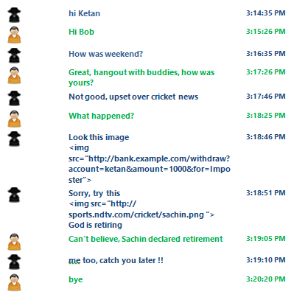
A8 – Cross-Site Request Forgery
OWASP Top10 Risks
Attacker tricks victim’s browser to send valid request using user’s access token without user’s consent
Exploiting state change, transactions, functionality access etc. due to absence of anti-automation control

Slide 21
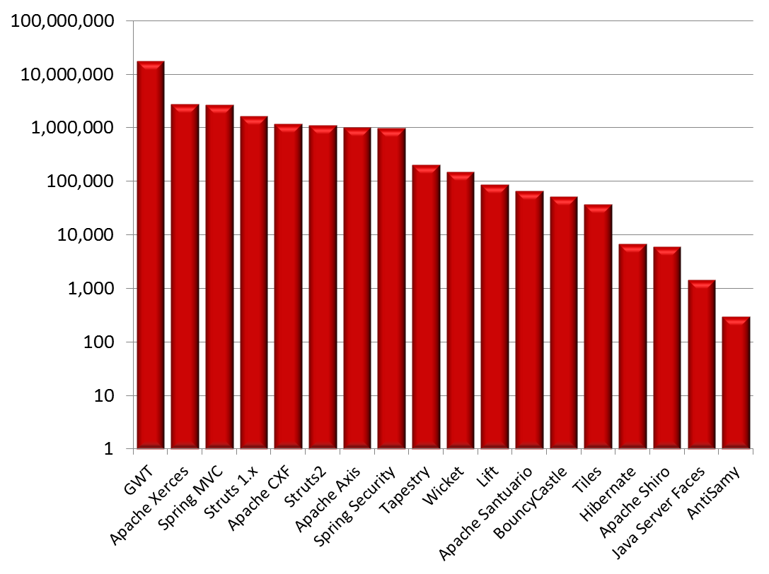
A9 – Using Known Vulnerable Components
OWASP Top10 Risks
Nobody wants to change running system
Vulnerable components in technology stack can be identified and exploited using automated tools
Out of date versions or unpatched software or dependent components evenif new versions are released
Libraries | 31
Library Versions | 1,261
Organizations | 61,807
Downloads | 113,939,358
Source: https://www.aspectsecurity.com/news/press/the-unfortunate-reality-of-insecure-libraries

Slide 22
A10 – Unvalidated Redirects and Forwards
OWASP Top10 Risks
Application redirect users to destination based on attacker supplied parameters
Attacker can also change internal forwards
Check for 3xx codes (especially 302 for browser based redirects)
bad.com
http://example.com/redirect.jsp?url=bad.com
Bad
Good

Slide 23
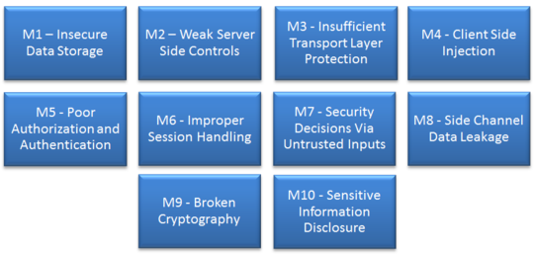
OWASP Mobile Top10 Risks
OWASP Top10 Risks
Source: https://www.owasp.org/index.php/OWASP_Mobile_Security_Project

Slide 24
Security Defect Patterns and Root causes

Slide 25
Tainted Data
OWASP Top10 Risks
User supplied data is interpreted as instruction
A1 – Injection
A3 – XSS
Mostly code level issue

Slide 26
Tainted Flow
OWASP Top10 Risks
Few flows are bypassed
A2 – Broken Authentication and Session Management
A7 – Missing Function Level Access Control
A10 – Unvalidated Redirects and Forwards
Mostly design level issue
A
B
C
D

Slide 27

Hidden Secrets
OWASP Top10 Risks
Secrets are stored as part of program files and accessible to users having knowledge about their locations or access methods
A4 – Direct Object Reference
A6 – Sensitive Data Exposure
A7 – Missing Function Level Access Control
Design flaws & code level issues

Slide 28
Ignorance
OWASP Top10 Risks
Security is not part of priority list
A5 – Security Misconfiguration
A9 – Using Known Vulnerable Components
Configuration issues

Slide 29
Tools & Techniques to Detect Vulnerabilities in Web/Mobile Applications

Slide 30
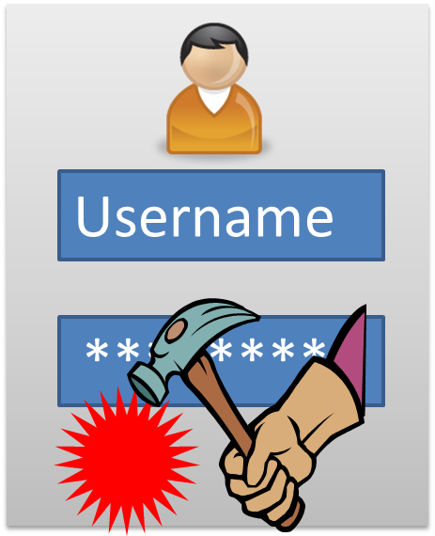
Dynamic Application Security Testing
Tools & Techniques to Detect Vulnerabilities in Web/Mobile Applications
Blackbox testing
Analysing running application and changing it’s state in unexpected ways through trial and error, behavior analysis etc.
Outside in approach to detect and exploit security defect
Independent of language / platform
Good for QA/Production phases
Mature and widely accepted
Password
Dynamic Application Security Testing (DAST)

Slide 31
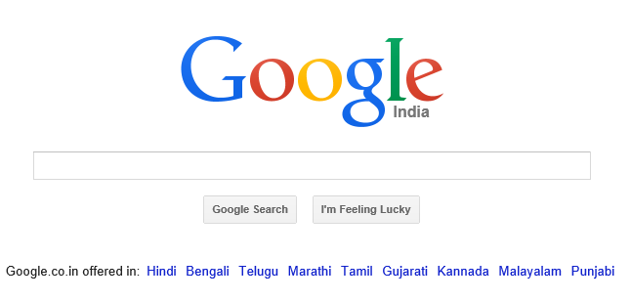
Using Google Search Engine
Tools & Techniques to Detect Vulnerabilities in Web/Mobile Applications
site:example.com
site:example.com filetype:pdf
site:example.com intitle:security
site:example.com inurl:security
site:example.com intext:security
cache:example.com
link:example.com
Source: www.google.com

Slide 32
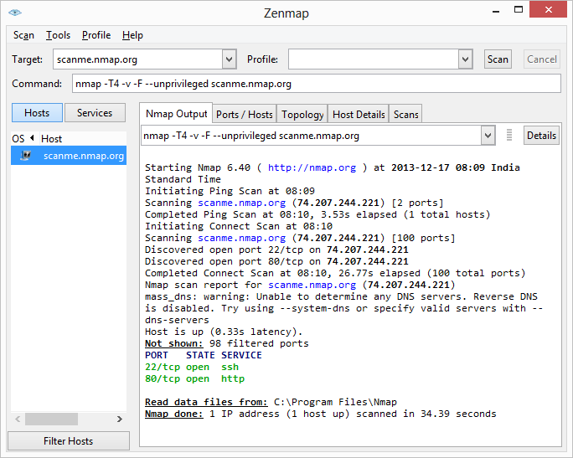
Port Scanning with NMAP
Tools & Techniques to Detect Vulnerabilities in Web/Mobile Applications
Host discovery
Identify open ports & Services
OS detection
Source: http://nmap.org/

Slide 33
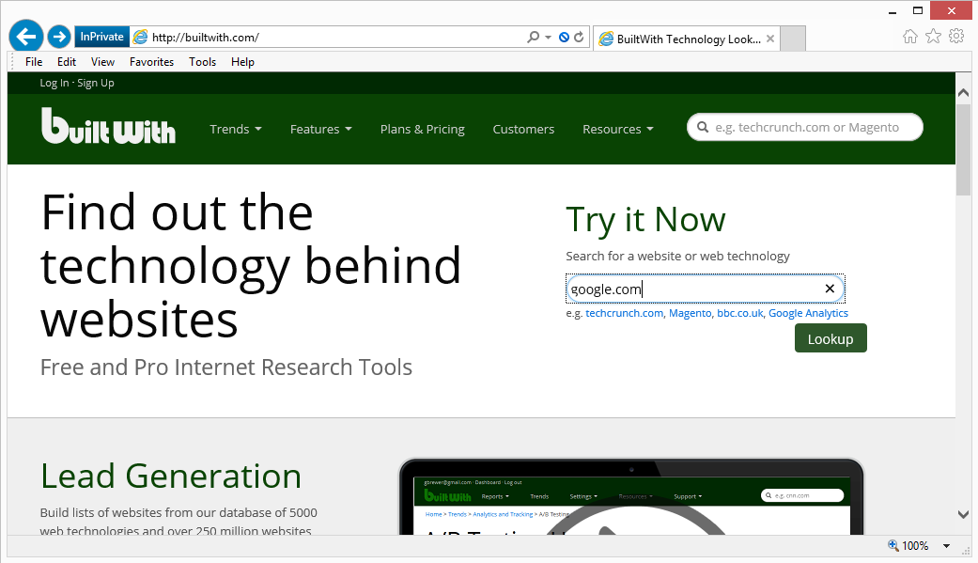
Technology Profiling with BuiltWith
Tools & Techniques to Detect Vulnerabilities in Web/Mobile Applications
Source: http://builtwith.com/

Slide 34
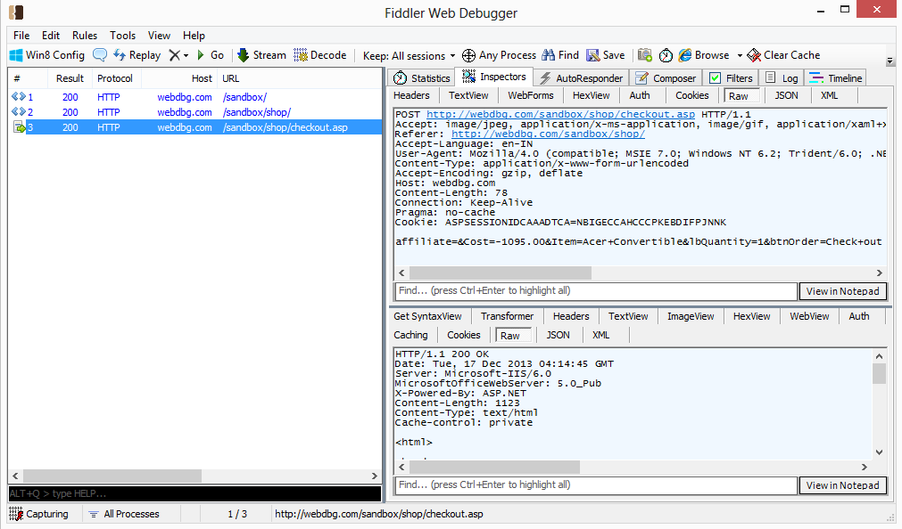
Analysis & Tampering with Fiddler
Tools & Techniques to Detect Vulnerabilities in Web/Mobile Applications
Source: http://fiddler2.com/

Slide 35





Setting Fiddler as Proxy for Mobile, Cloud and COTS applications
Tools & Techniques to Detect Vulnerabilities in Web/Mobile Applications
In-House application
Hosted application
Clients
Fiddler
Fiddler
Example.com

Slide 36
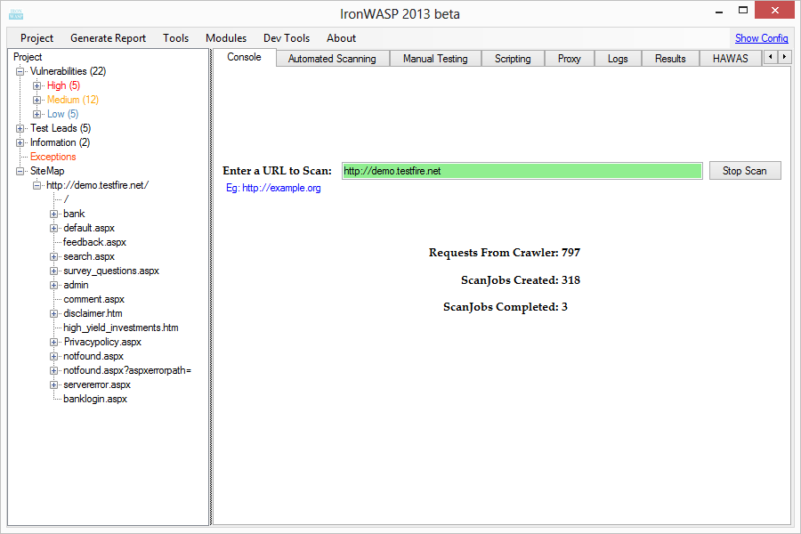
Automated Scanning with IronWASP
Tools & Techniques to Detect Vulnerabilities in Web/Mobile Applications
Source: http://ironwasp.org/

Slide 37
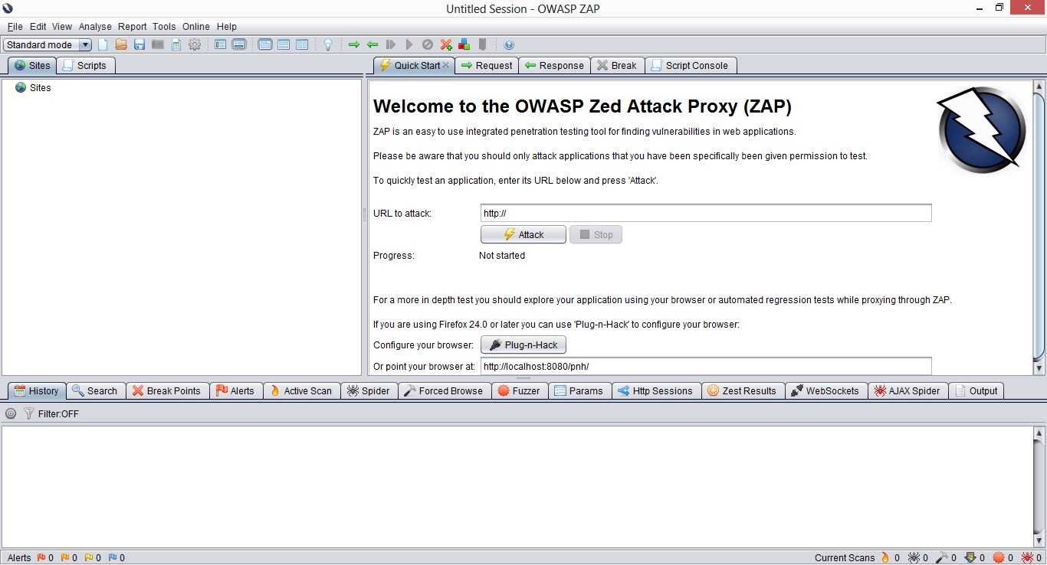
Manual Assessment with ZAP
Tools & Techniques to Detect Vulnerabilities in Web/Mobile Applications
Source: https://www.owasp.org/index.php/OWASP_Zed_Attack_Proxy_Project

Slide 38
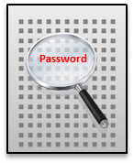
Static Application Security Testing
Tools & Techniques to Detect Vulnerabilities in Web/Mobile Applications
Whitebox testing
Analysing source code, bytecode or native binary
Inside out approach to find conditions indicative of a security defect
Does not require application execution
Language / platform dependent
Analysing third party library
Good for Dev/QA phases
Static Application Security Testing (SAST)

Slide 39
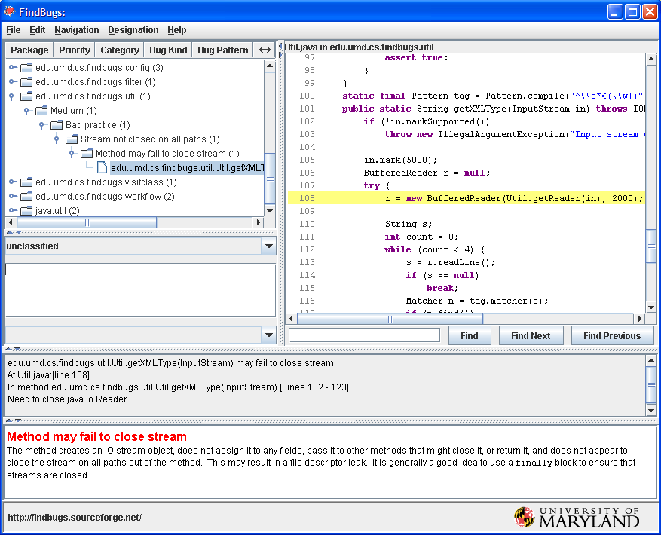
Java Code Review using FindBugs
Tools & Techniques to Detect Vulnerabilities in Web/Mobile Applications
Static code analysis through byte code analysis
Code Correctness
Bad Practices
Confusing constructs
Source: http://findbugs.sourceforge.net/

Slide 40
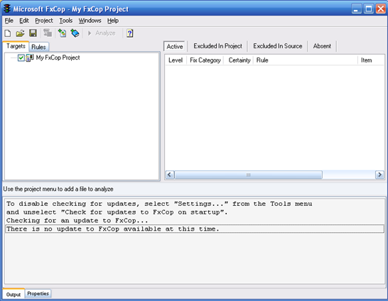
.Net Code Review using FxCop
Tools & Techniques to Detect Vulnerabilities in Web/Mobile Applications
Review .Net assembly for conformance to the Microsoft .NET Design Guidelines
Discover bugs related to Quality through metadata, IL, callgraphs (design, localization, conventions etc.)
NFR - Performance, security
Source: http://www.microsoft.com/en-in/download/details.aspx?id=6544

Slide 41
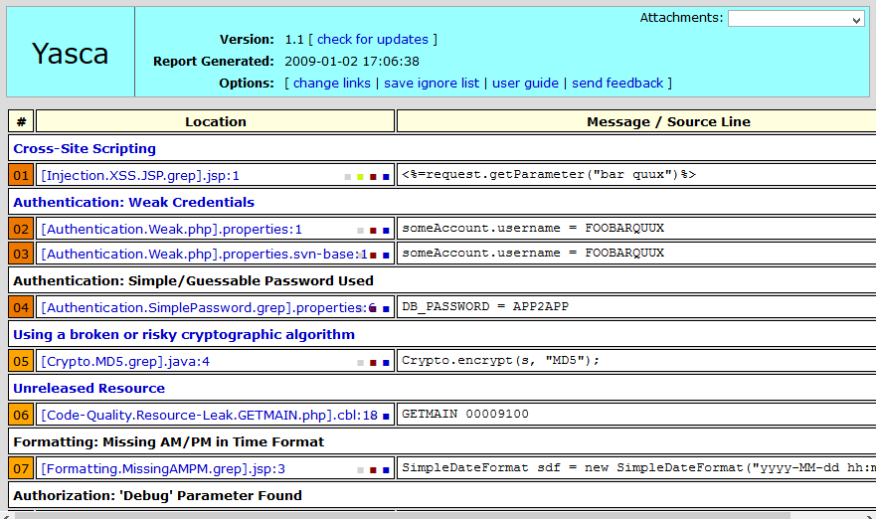
Source Code Review with YASCA
Tools & Techniques to Detect Vulnerabilities in Web/Mobile Applications
Yet Another Source Code Analyser combines output from FindBugs, PMD, JLint, JavaScript Lint, PHPLint, Cppcheck, ClamAV, RATS, and Pixy
Java, JSP, C/C++, PHP, ASP, Visual Basic, COBOL, HTML, JavaScript, CSS
Source: http://scovetta.github.io/yasca/

Slide 42

Interactive Application Security Testing
Tools & Techniques to Detect Vulnerabilities in Web/Mobile Applications
Blackbox + Whitebox testing
Combining source code and application runtime behavior analysis
Inside out + Outside in approach to accurately identify security defect
Uses instrumentation agent on server
Language / platform dependent
Good for Dev/QA phases and not suitable for production phase
Password
Interactive Application Security Testing
(IAST)

Slide 43
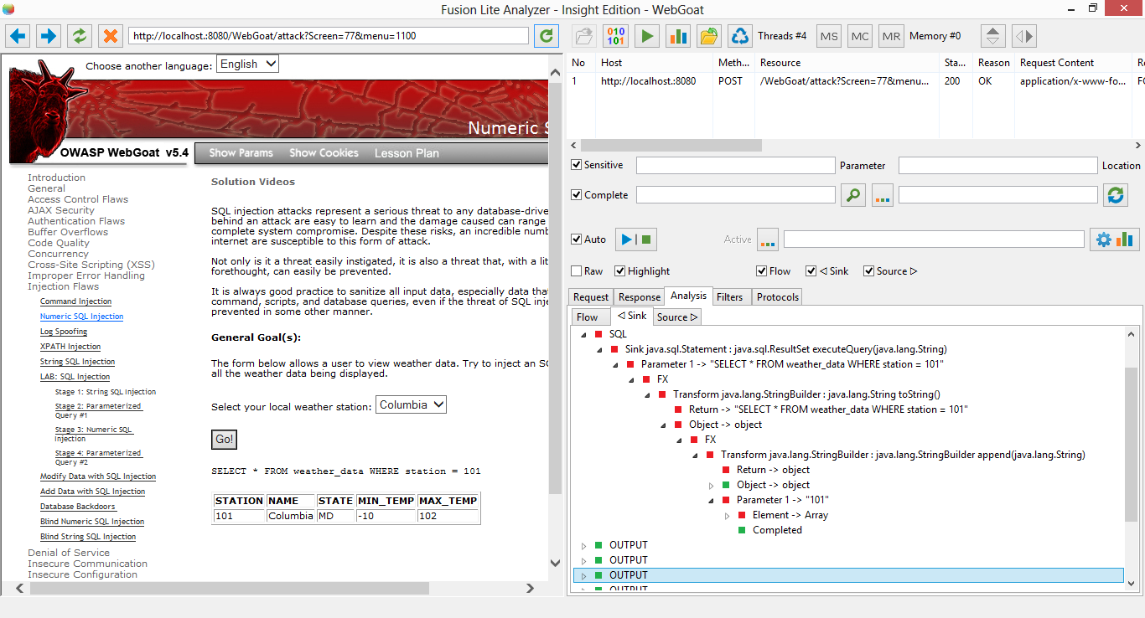
Instrumentation with FusionLite Insight
Tools & Techniques to Detect Vulnerabilities in Web/Mobile Applications
Source: http://www.iappsecure.com/downloads.html

Slide 44
Security Testing Data Management

Slide 45
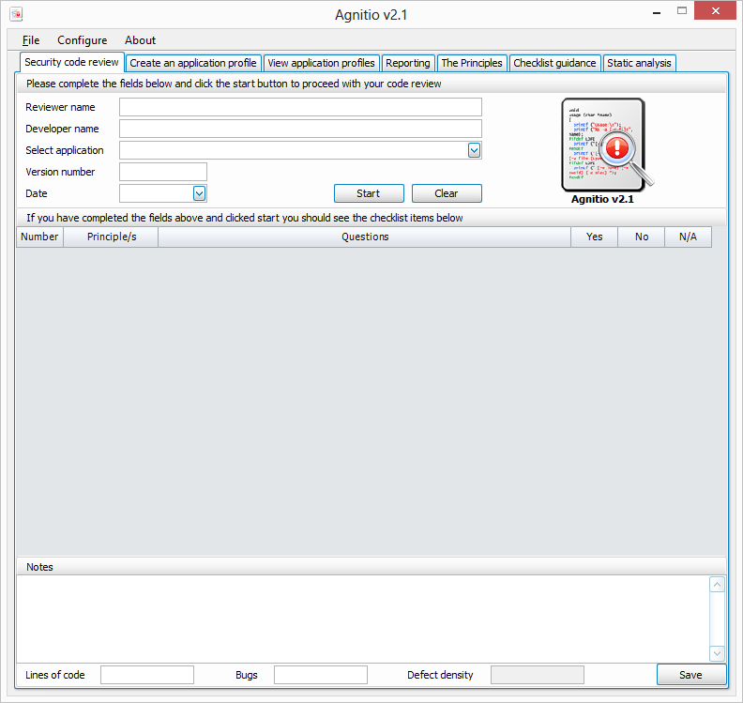
Code Review Data using Agnitio
Security Testing Data Management
Source: http://sourceforge.net/projects/agnitiotool/

Slide 46
Vulnerability Tracking with ThreadFix
Security Testing Data Management
Source: http://code.google.com/p/threadfix/

Slide 47
Reducing Security Risk with Secure Coding

Slide 48
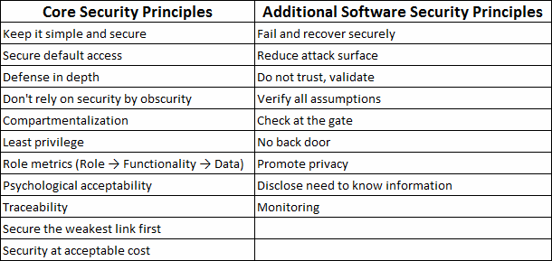
Security Principles
Reducing Security Risk with Secure Coding

Slide 49
Bad Coding Practice is a Primary Reason for Application Security Failure
Reducing Security Risk with Secure Coding
bIsAdmin = true;
try
{
MyFunction ();
bIsAdmin = isAdminUser(userName);
}
catch (Exception ex)
{
log.write(ex.toString());
}

Slide 50
The Solution – Learn Good Practices
Reducing Security Risk with Secure Coding
Secure Coding Practices for .Net
Secure Coding Practices for Java

Slide 51
Thank you

